Slide 1
Lab visit & Photolithography technique
2021.3.3 Kexin Li
Supported by Dr. Chang Shannan
Lab 513-517

Slide 2

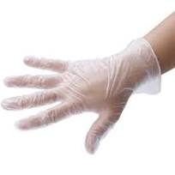
Preparation for the Lab
Before entering the lab
Wear mask, rubber gloves, shoe cover, hair cover and garment for clean room
If use beakers
Wash the equipment with dishwashing liquid, wash out
Wear the black acid and alkali resistant gloves
Put the equipment into a cask containing the alkali solution
Soak at least one night
Rinse the beakers with tap water, followed with bulk of ultrapure water (超纯水)
Put them into the drying box to dry if needed.

Slide 3
What we want to do in the Lab: Photolithography
Principle:
Photoresist (PR, 光刻胶，光阻) is sensitive to light.
When it is exposed to UV(紫外光), its chemical properties changes, and it can be removed by Developer (显影液); while the part shadowed by mask cannot be removed.
Main Function:
Transfer the circuit diagram of the chip from the mask to the silicon wafer.

Slide 4
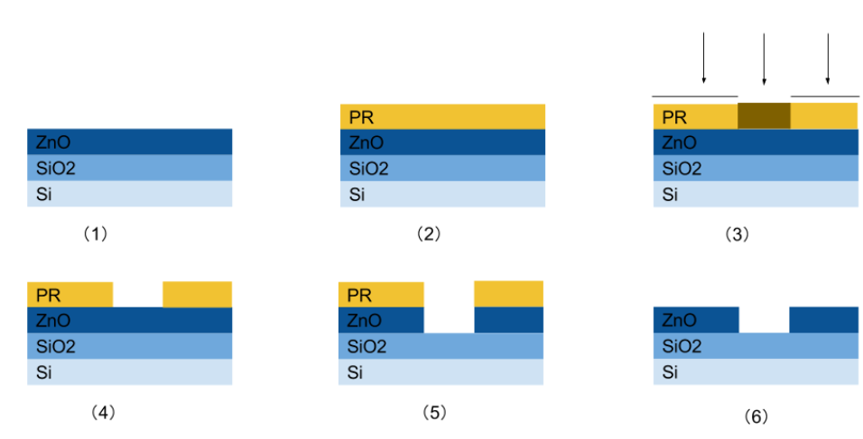
General Process
Change properties
due to UV
SoftBake
Shadow mask
Quartz & chrome
(光刻板/掩模版)
Substrate Pre-treatment
photoresist
UV
Wafer(substrate) to be processed
bases
Spin-coating(旋涂)
Exposure(曝光)
The PR is
washed
away
Post exposure bake
Develop(显影)
Etching*(刻蚀)
Cleaning
Use acid to etch the ZnO,
while PR will not react with acid.
The PR is washed away by
organic solvent.
Notes:
https://nanoscale.unl.edu/pdf/Photolithography_Powerpoint.pdf
https://en.wikipedia.org/wiki/Photolithography
https://zhuanlan.zhihu.com/p/26617030
https://zhuanlan.zhihu.com/p/178719145
光刻板就是在石英板上镀上呈某种图案排列的铬金属。石英透光，金属不透光。
前烘目的：去除光刻胶中的溶剂、增强黏附性、释放光刻胶膜内应力以及防止光刻胶污染设备；
后烘：在曝光之后的光刻胶膜的烘烤过程。由于光刻胶膜还未显影，也就是说还未闭合，PEB也可以在高于光刻胶软化温度的情况下进行。
Etching: a liquid ("wet") or plasma ("dry") chemical agent removes the uppermost layer of the substrate in the areas that are not protected by photoresist.
In semiconductor fabrication, dry etching techniques are generally used, as they can be made anisotropic, in order to avoid significant undercutting of the photoresist pattern.

Slide 5
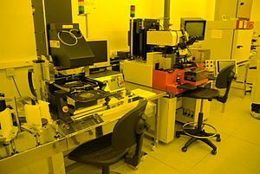
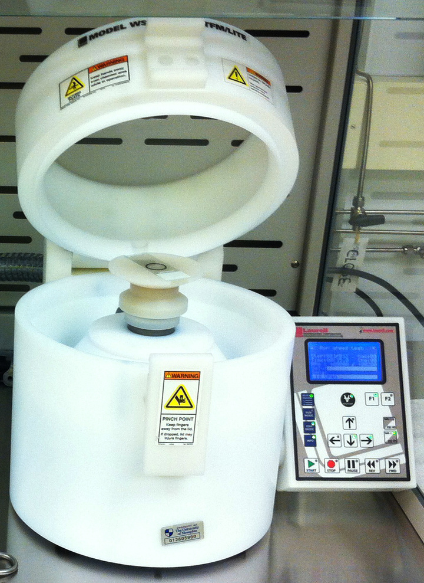
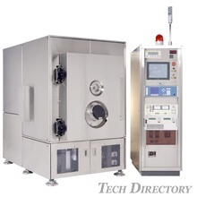
Facilities

Slide 6
What we want on our chip
Electrodes
Microfluidic channel
What we need / need to do?
A shadow mask that has the diagram of our design.
A substrate.
By photolithography…
Put the metal (gold, electrodes) on the substrate.
Put the channel on the substrate.

Slide 7
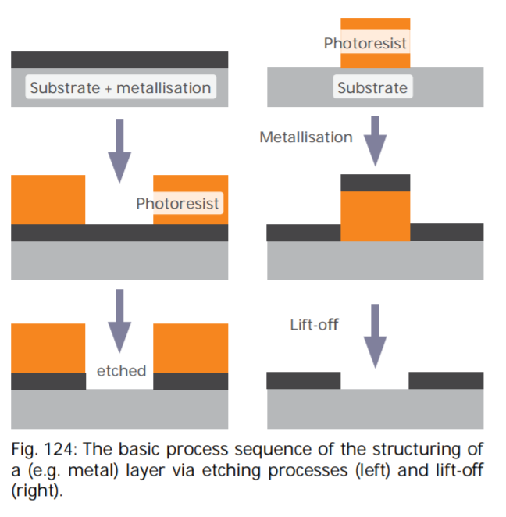
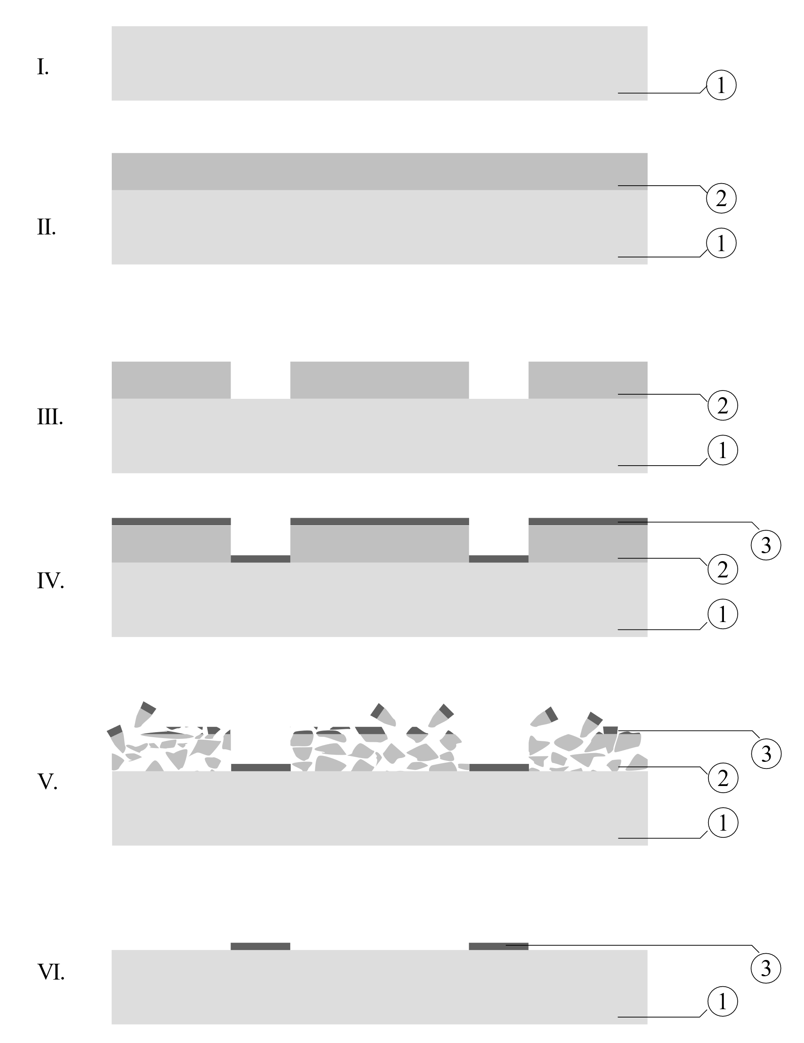
Make the electrodes
Lift-off (usually a thin metal layer)
Notes:
https://en.wikipedia.org/wiki/Lift-off_(microtechnology)
https://www.microchemicals.com/downloads/application_notes.html
https://www.microchemicals.com/technical_information/lift_off_photoresist.pdf

Slide 8
Why we use lift-off instead of etching
Lift-off
Cheap, protect the lower layer
When using wet etching, the poor adhesion of the protective resist mask will bring damage to the protected metal under it.
Disadvantages:
Residual of the metals and resist.
Unexpected lift-off of the metal we want to save.
Unexpected deposition of the metal that should be removed.
The deposition of the metal forms “ears”.
Etching
Wet etching
Dry etching
Notes:
Lift-off: 因为是靠光刻胶使得金属层断裂开，金属能够飘落到没有覆盖胶的地方。如果金属过厚，可能就无法很好的分层断裂开。
Wet etching: 利用化学试剂刻蚀金属层，PR在这里是保护层
Dry etching：使用离子轰击的方式，刻蚀金属
https://en.wikipedia.org/wiki/Dry_etching
https://en.wikipedia.org/wiki/Lift-off_(microtechnology)
https://en.wikipedia.org/wiki/Etching_(microfabrication)#Wet_etching

Slide 9
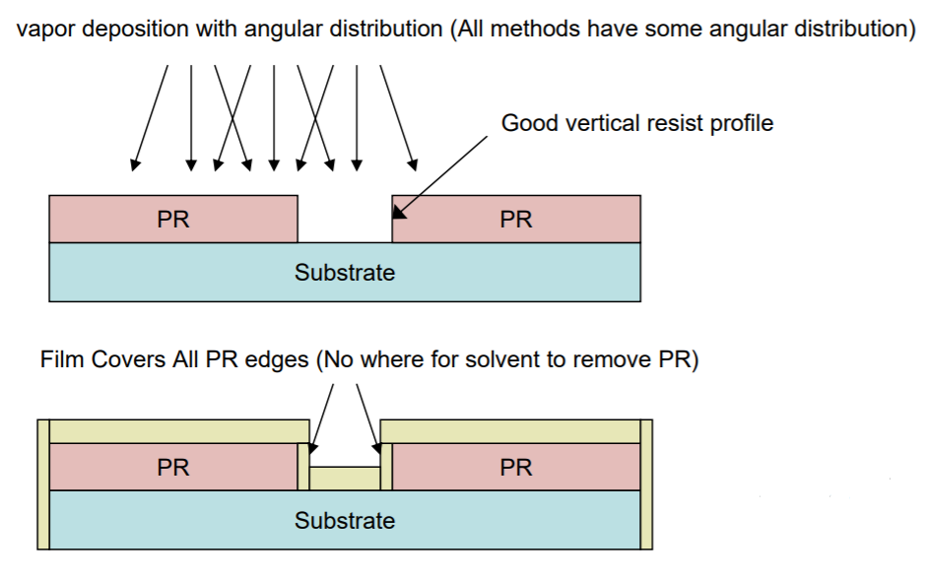
Notes:
https://wiki.nanotech.ucsb.edu/w/images/b/bc/Liftoff-Techniques.pdf

Slide 10
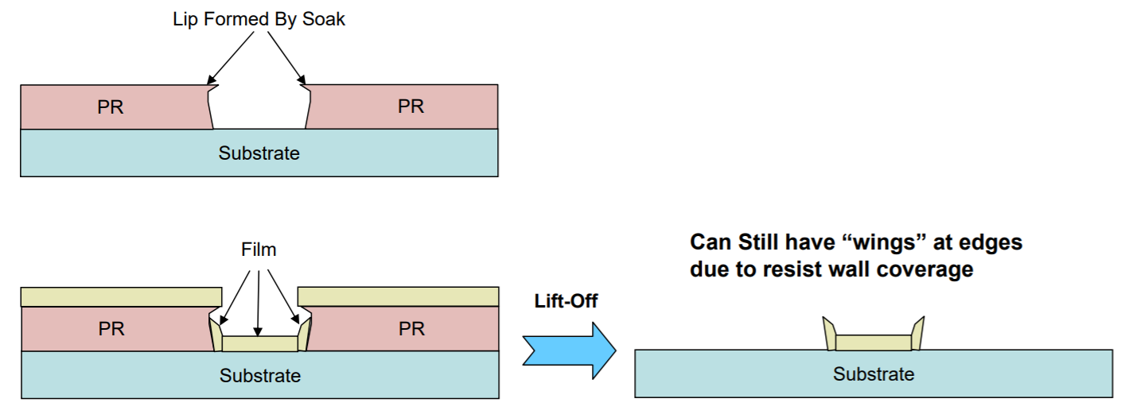
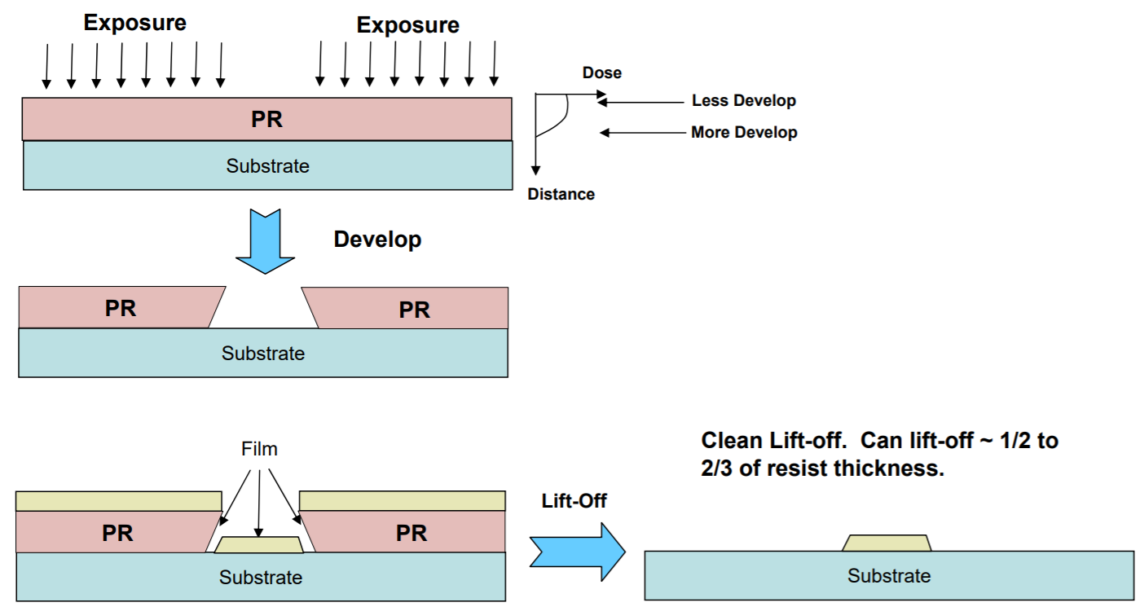
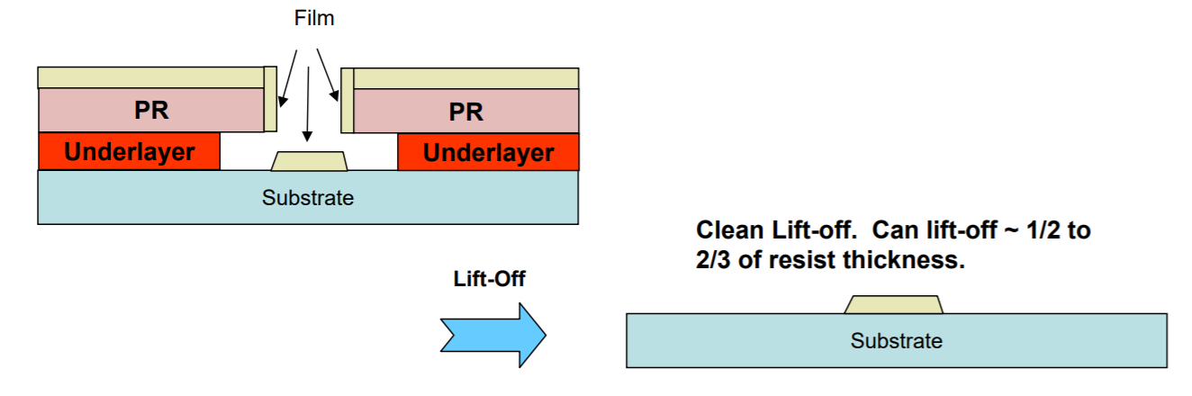
Methods
Methods 1
Methods 3
Methods 2
Notes:
https://wiki.nanotech.ucsb.edu/w/images/b/bc/Liftoff-Techniques.pdf

Slide 11
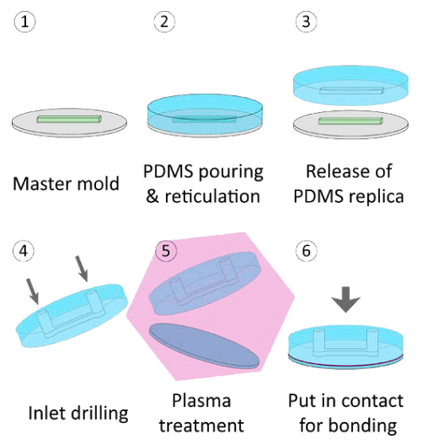
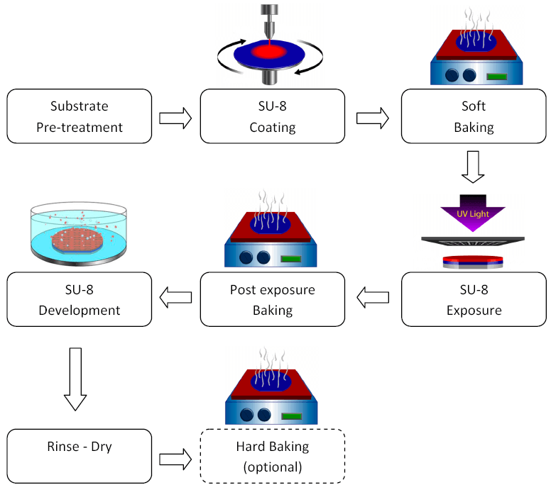
Make the fluidic channel
SU-8 mold
PDMS channel
Notes:
https://www.elveflow.com/archives-fr/poly-di-methyl-siloxane-pdms-et-la-microfluidique/
https://www.elveflow.com/microfluidic-reviews/soft-lithography-microfabrication/su-8-mold-lithography/
Spin-coating: The rotation speed, the acceleration and the SU-8 photoresist viscosity will define the thickness of the SU-8 photoresist layer.
Why we need PEB?
The UV exposure activates the photoactive components in the SU-8 photoresist, but it needs energy to continue the reaction; this bake brings that energy.
Why we need hard baking?
A lot of strength remain inside the SU-8 photoresist at the end of the process that can create cracks on the surface or even delamination of the layer… The hard bake heats the SU-8 photoresist at high temperature (more than 120°C) to suppress these strengths.

